Slide 1
Low-Power Analog Bayesian Classifier for Diabetes Detection
Charalampos Papadopoulos, ECE, NTUA

Slide 2
Table of contents
01
04
02
05
03
06
Introduction
Classifier Analysis
Initial Bump Design
Inference
Updated Bump Design
Conclusions

Slide 3
Introduction
Analog Classifiers
Hardware equivalent of software-based ML classifiers
Built using Bump Circuits + Bayesian/Gaussian models
Can directly classify analog input signals
Why Analog?
Ultra-low power – ideal for edge/wearable devices
Real time processing of sensor outputs
Application: Diabetes Detection
Diabetes = major global healthcare challenge
Goal: enable smart, low-power medical wearables.
Stepping stone for advanced health monitoring.

Slide 4
2. Initial Bump Design

Slide 5
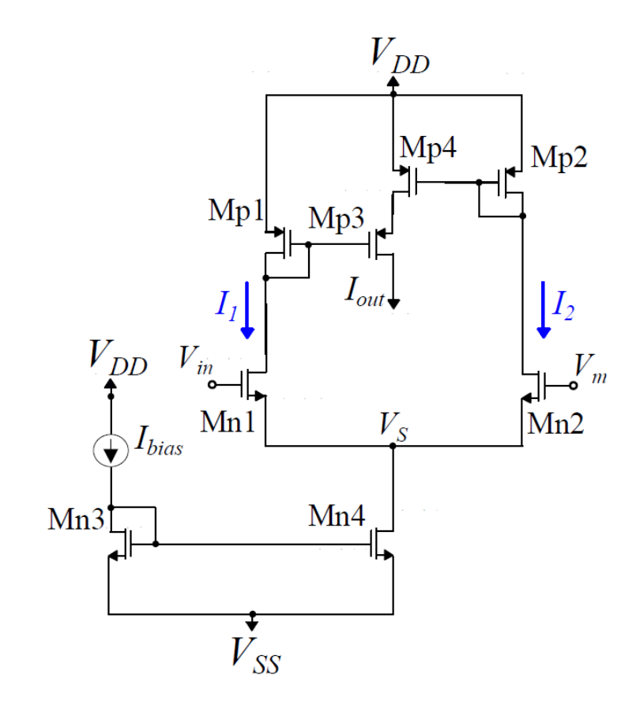

2.1 – Delbruck’s Design
Proposed by T. Delbruck in 1991
Two main blocks: Differential Input and Assymetric Current Correlator
Sub-threshold operation
Generates Gaussian-like current output
$Iout= \frac{I_{bias}S }{4\cosh^{2}{(\frac{κV_{in}−V_{mean}}{2})}}$
$I_{bias}$ and $V_{mean}$ control the height and the mean value, respectively.
Quantity S is given as such:
$S= \frac{{\left(\frac{W}{L}\right)}_{3,4}}{{\left(\frac{W}{L}\right)}_{1,2}}$
$κ$ is the slope factor and $V_{in}$ is the input voltage
Theoretical $V_{mean}$ tunability

Slide 6
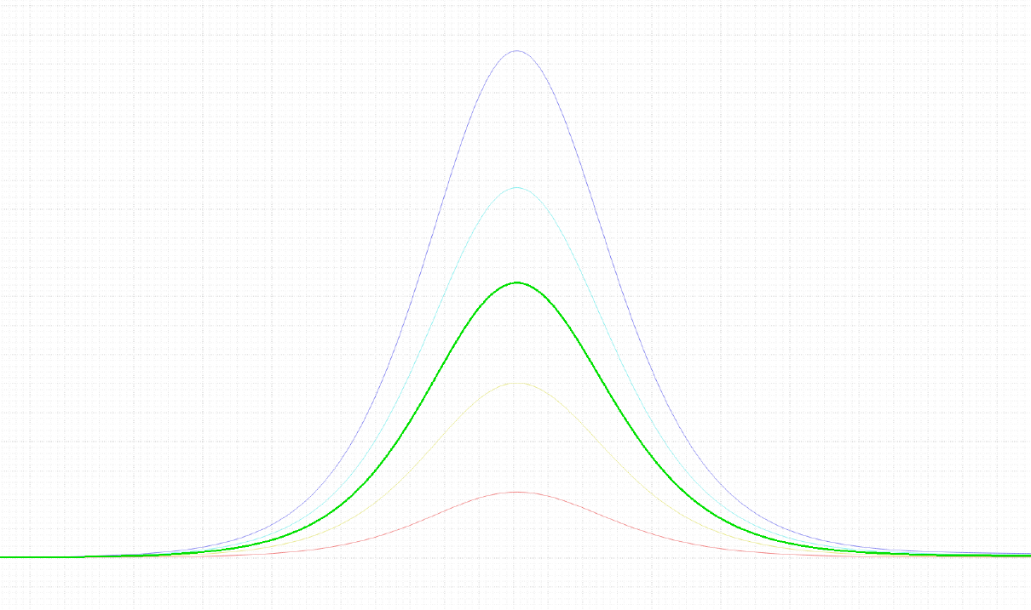
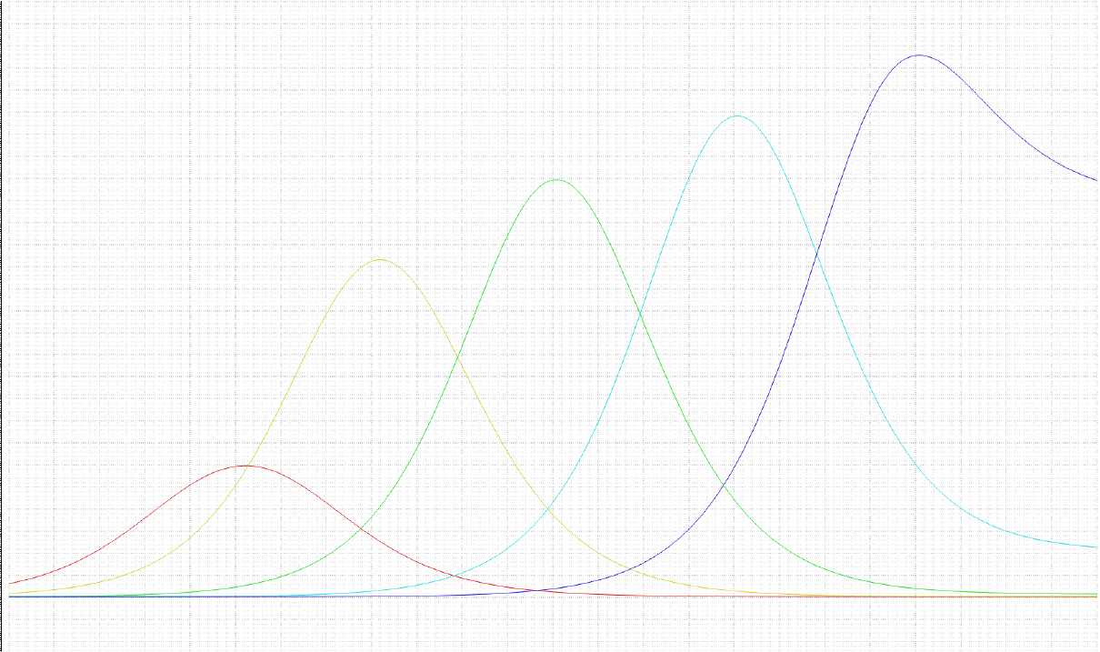
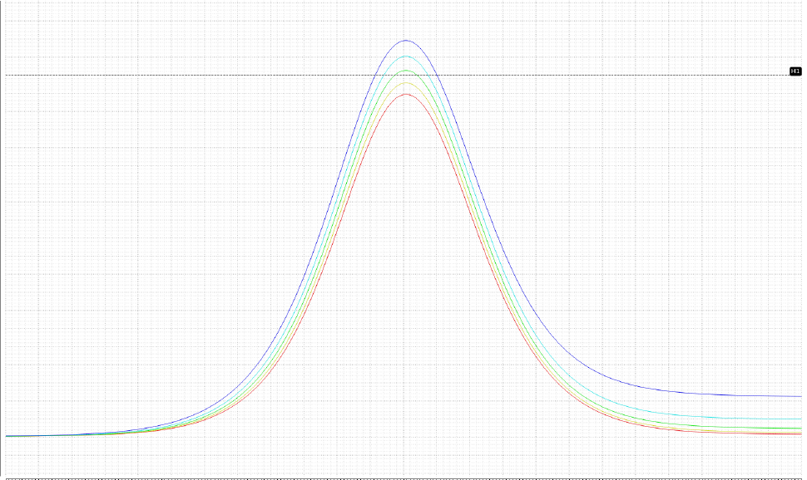



2.2 – Tunability of original bump
$I_{bias}$ sweep
$V_{mean}$ sweep
$V_{C}$ sweep

Slide 7
3. Updated Gaussian Bump Design

Slide 8
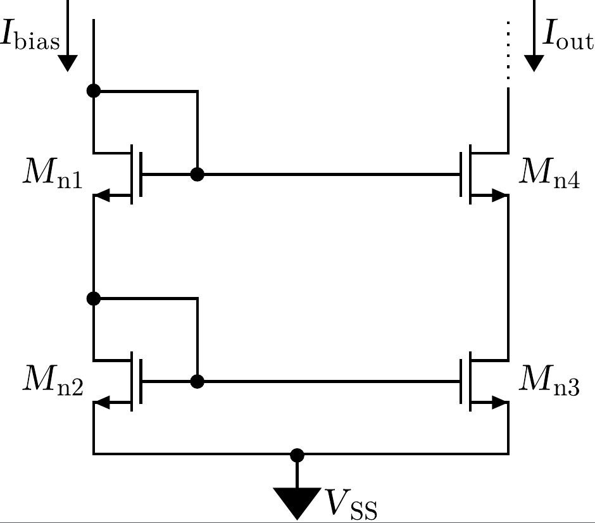
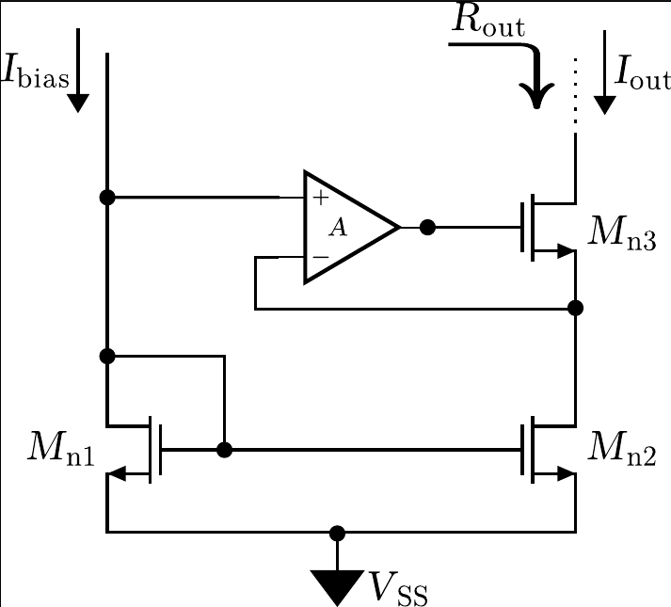



3.1 Current Mirror
Biases the differential input
Finite output resistance $→$ source fluctuations leading to bad performance when shifting $V_{mean}$ to lower values
Mitigations
Increase channel length (L); $r_{ds}≅∝\frac{1}{λ∗I_{D}}∝\frac{L}{I_{D}}$
Change configuration
Cascoded Current Mirror
$r_{out}≅g_{m}∗r_{ds}^{2}$
Opamp Feedback Current Mirror
$$r_{out}≅g_{m3}∗r_{ds3}∗r_{ds5}∗(A+1)$$

Slide 9
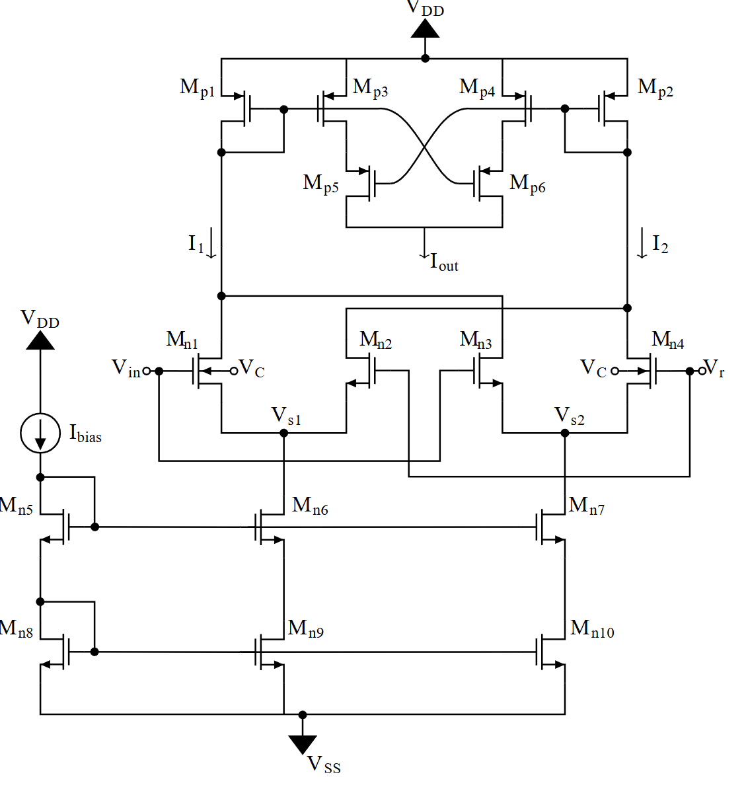

3.2 – Updated Design
Differential Difference Pair (DDP):
Used as high-linearity voltage-to-current converter
Provides tunability and better common-mode rejection than a simple differential pair
$M_{n1}$ and $M_{n4}$ are bulk controlled
Sizing Considerations:
W/L $≅$ 1 with larger devices
$W_{2,3}=3∗W_{1,4}$ in order to eliminate offset
Symmetric Current Correlator (SCC):
Eliminate asymmetries caused by original design
Sizing considerations:
Keep all transistors in the subthreshold region
Larger W offers more voltage headroom

Slide 10
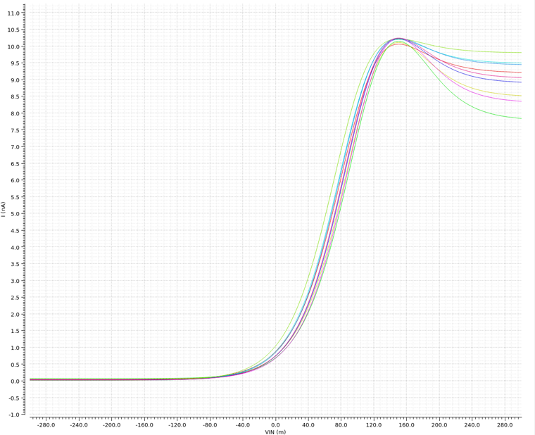
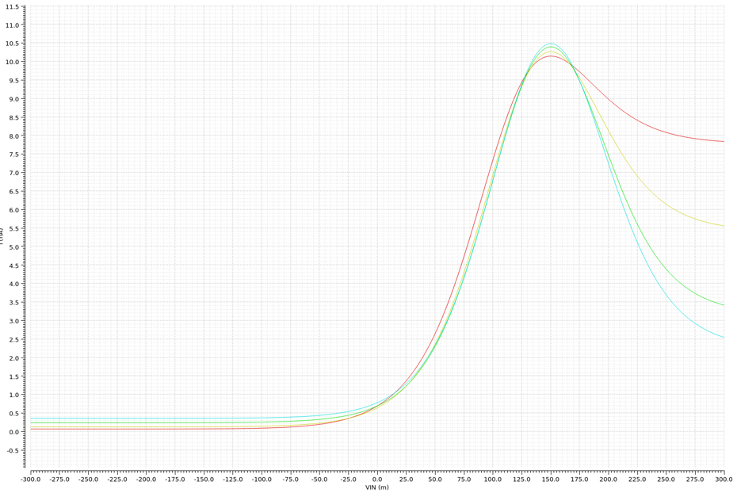
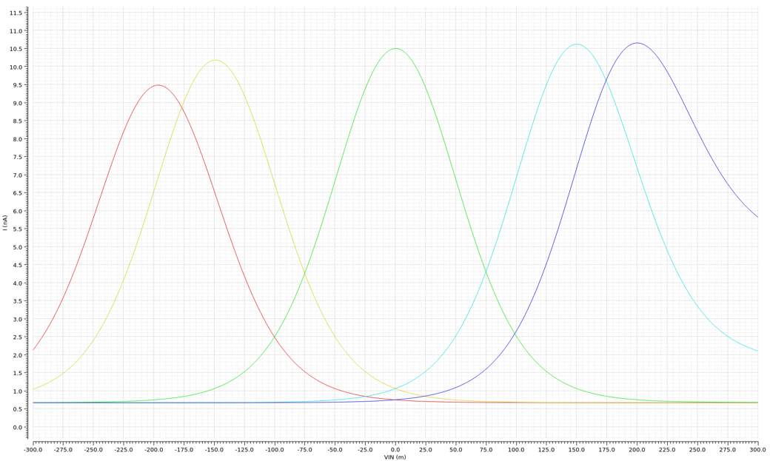
3.3 – Fingers and Multipliers for the SCC
F = 1, m = 1, 2, 4, 6
F = 2, m = 1, 2, 4, 6
F = 8, m = 10

Slide 11
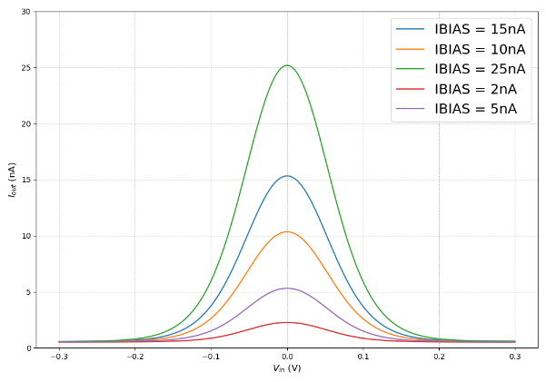
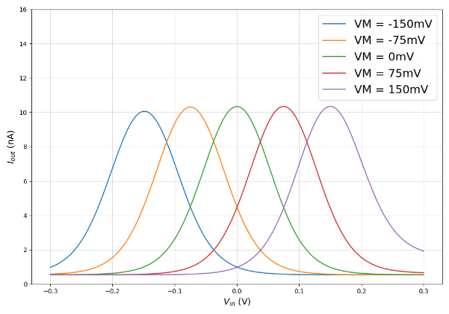
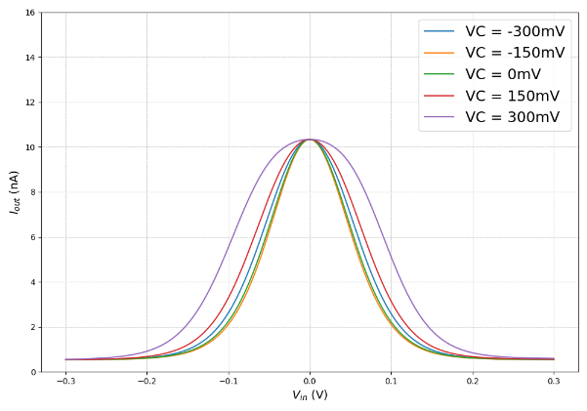

3.4 – Tunability of our design
$I_{bias}$ sweep
$V_{mean}$ sweep
$V_{C}$ sweep

Slide 12
4. Classifier Architecture

Slide 13

4.1 – Theoretical Models
Gaussian Mixture Model (GMM):
Each class represented as a mixture of Gaussian functions
Probability density for input x:
$$p\left(x | C_{k}\right)=\sum_{i=1}^{n}{w_{k,i}}⋅𝒩\left(x;μ_{k,i},σ_{k,i}^{2}\right)$$
Bayesian Classification:
Posterior probability
$$P\left(C_{k} | x\right)=\frac{p\left(x | C_{k}\right)⋅P\left(C_{k}\right)}{\sum_{j}{p\left(x | C_{j}\right)}⋅P\left(C_{j}\right)}$$
Decision rule: assign x to class with highest posterior probability

Slide 14
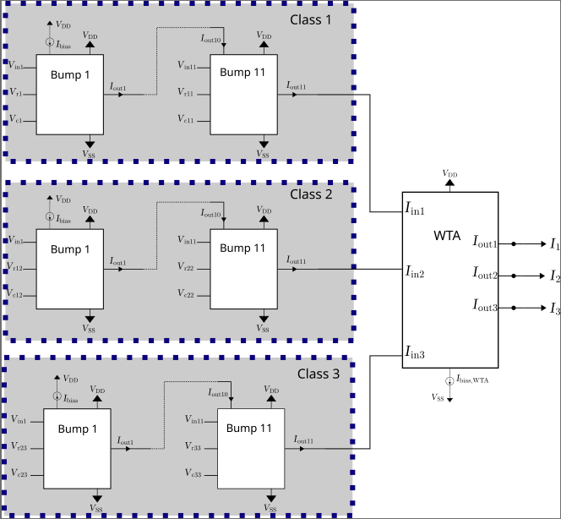

4.2 – Hardware Implementation
Implements Bayesian model: maps input features to class probabilities
Each class: n cascaded Bump circuits (n = number of input features; 11 for diabetes dataset)
Cascaded: output of one bump serves as input to the next, multiplying the feature likelihoods to compute the joint probability.
Each feature is converted into $V_{mean}$ and $V_{C}$ values based on the dataset and code preprocessing
Each class outputs $I_{out}$, with peak magnitude indicating the likelihood of belonging to that class
Winner-Take-All (WTA) circuit performs the argmax operator
$$\hat{C}=\arg{\max_{k}{I_{out,k} }}$$
Digital output suitable for further processing

Slide 15
5. Inference

Slide 16

5.1 – The Diabetes Dataset
Samples: Real-world patient data with multiple risk factors
Features (11 total):
Demographics: Gender, Age, BMI
Kidney function: Urea, Creatinine
Glucose control: HbA1c
Lipid profile: Chol, TG, HDL, LDL, VLDL
Target Classes (multi-class):
0 = Non-Diabetic
1 = Diabetic
2 = Predict-Diabetic (at risk)
Features vary in scale and range → require normalization & mapping to circuit parameters ($V_{mean}$ and $V_{C})$
Chosen for relevance: Diabetes = a critical health issue with global prevalence

Slide 17
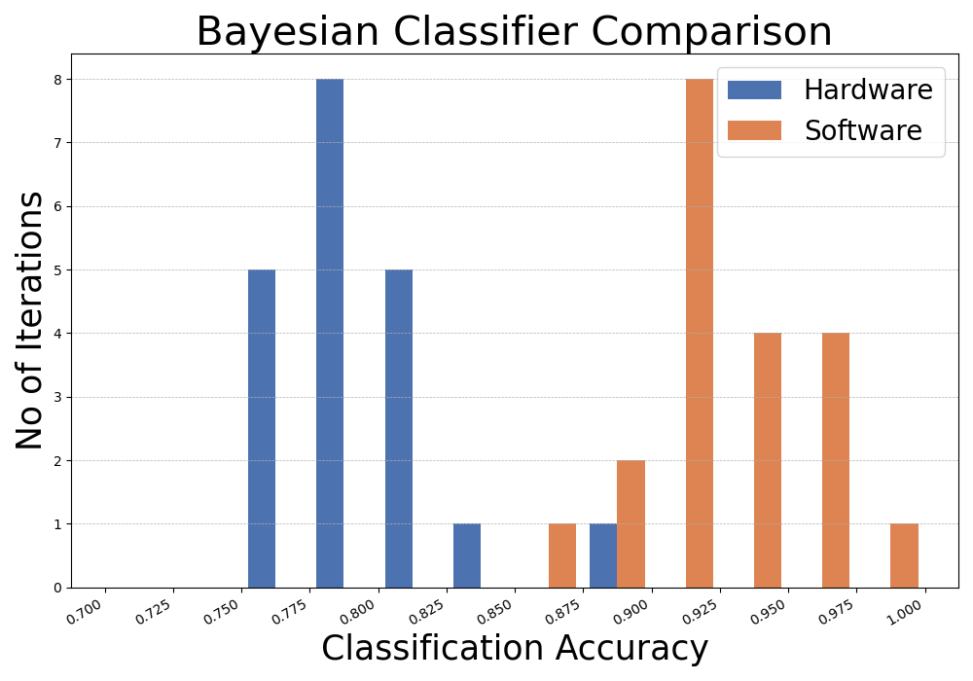
5.2 – Performance Summary
Software vs Hardware
Performance Summary
Method | Best | Worst | Mean | Std.
Software | 0.99 | 0.87 | 0.93 | 0.03
Hardware | 0.89 | 0.75 | 0.79 | 0.03
Technology | Power Supply | Power Consumption | Classification Speed
130nm | 0.6V | 114nW | 20K

Slide 18

6. Overview & Conclusions
Results
Tested on a real diabetes dataset
Achieved $≅$80% accuracy (vs. $≅$93% in software)
Ultra-low power: 114$nW$ at 0.6 V supply
Key Takeaway
Proof-of-concept for low-power, real-time medical classifiers
Potential path toward smart wearable devices for health monitoring
Future work
Improve accuracy with extended feature handling
Integration with on-chip sensors & larger datasets

Slide 19
Thank you!
Do you have any questions?
harrispap10@gmail.com

